Slide 1
#02 Peer to Peer Networking
Client/Server Computing and Web Technologies

Slide 2
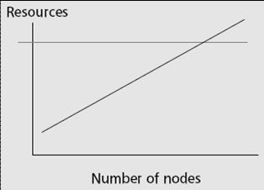
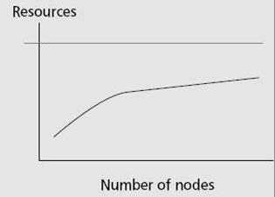
The architectures
Server-based architecture
Client-Server / Server-Cluster
Problems：
Limited resources
All loads are centered on the server
Server-based architecture has low scalability.
The setup and maintenance cost is high.
Peer-to-Peer (P2P) architecture
Advantages：
Distributing loads to all users
Users consume and provide resources
P2P architecture has high scalability.
The setup and maintenance cost is low.

Slide 3
Peer-to-peer (P2P)
“Peer-to-peer is a way of structuring distributed applications such that the individual nodes have symmetric roles. Rather than being divided into clients and servers each with quite distinct roles, in P2P applications a node may act as both a client and a server.”
-- Charter of Peer-to-peer Research Group, IETF/IRTF, June 24, 2004 (http://www.irtf.org/charters/p2prg.html)

Slide 4
Classification of P2P systems
Hybrid P2P – Preserves some of the traditional C/S architecture. A central server links between clients, stores indices tables, etc
Napster
Unstructured P2P – no control over topology and file placement
Gnutella, Morpheus, Kazaa, etc
Structured P2P – topology is tightly controlled and placement of files are not random
Chord, CAN, Pastry, Tornado, etc
Notes:
Morpheus
the Greek god of dreams and of sl51p
【希】【神話】睡夢之神
Tornado
a violent and destructive whirlwind, in the form of a funnel-shaped cloud moving on a long and narrow path
龍捲風

Slide 5
The lookup problem
N₂
N₁
N₃
Key=“title”
Value=MP3 data…
Internet
?
Client
Publisher
Lookup(“title”)
N₄
N₆
N₅
Notes:
1000s of nodes.
Set of nodes may change…

Slide 6
Centralized lookup (Napster)
N₁
N₂
SetLoc(“title”, N4)
N₃
Client
Publisher@
N₄
DB
Lookup(“title”)
Key=“title”
Value=MP3 data…
N₈
N₉
N₇
N₆
Simple, but O(N) state and a single point of failure
Notes:
O(N) state means its hard to keep the state up to date.

Slide 7
Flooded queries (Gnutella)
N₁
N₂
Lookup(“title”)
N₃
Client
Publisher@
N₄
Key=“title”
Value=MP3 data…
N₆
N₇
N₈
N₉
Robust, but worst case O(N) messages per lookup

Slide 8
Routed queries (Freenet, Chord, etc.)
N₁
N₂
N₃
Client
N₄
Lookup(“title”)
Publisher
Key=“title”
Value=MP3 data…
N₆
N₇
N₈
N₉
Notes:
Challenge: can we make it robust? Small state? Actually find stuff in a changing system?
Consistent rendezvous point, between publisher and client.

Slide 9



Napster Sharing Style: hybrid center + edge
Title User Speed
song1.mp3 beasiteboy DSL
song2.mp3 beasiteboy DSL
song3.mp3 beasiteboy DSL
song4.mp3 kingrook T1
song5.mp3 kingrook T1
song5.mp3 slashdot 28.8
song6.mp3 kingrook T1
song6.mp3 slashdot 28.8
song7.mp3 slashdot 28.8
1. Users launch Napster and connect to Napster server
2. Napster creates dynamic directory from users’ personal .mp3 libraries
3. beastieboy enters search criteria
s
o
n
g
5
4. Napster displays matches to beastieboy
“beastieboy”
song1.mp3
song2.mp3
song3.mp3
“kingrook”
song4.mp3
song5.mp3
song6.mp3
“slashdot”
song5.mp3
song6.mp3
song7.mp3
5. beastieboy makes direct connection to kingrook for file transfer
song5.mp3

Slide 10
Gnutella Protocol
Scenario: Joining Gnutella Network
The new node connects to a well known ‘Anchor’ node or ‘Bootstrap’ node.
Then sends a PING message to discover other nodes.
PONG messages are sent in reply from hosts offering new connections with the new node.
Direct connections are then made to the newly discovered nodes.
Gnutella Network
New
PING
PING
PING
PONG
PING
PING
A
PING
PING
PONG
PING
PING
PING

Slide 11
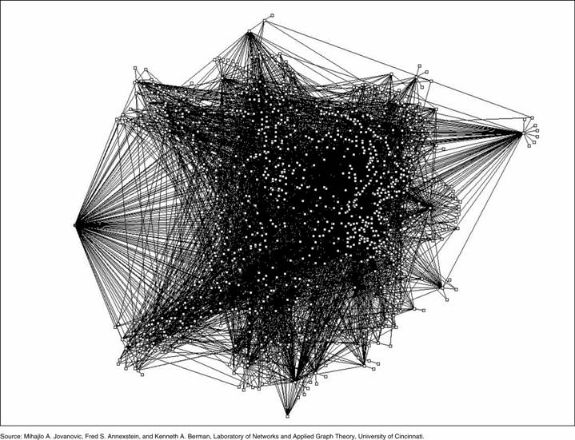
Topology of a Gnutella Network

Slide 12
Gnutella: Flood the Request
Result
Fully distributed storage and directory!

Slide 13
So Far/We Want
So Far
Centralized :
- Directory size – O(n)
- Number of hops – O(1)
Flooded queries:
- Directory size – O(1)
- Number of hops – O(n)
We Want
Efficiency : O(log(n)) messages per lookup
Scalability : O(log(n)) state per node
Robustness : surviving massive failures
n: number of participating nodes

Slide 14



How Can It Be Done?
How do you search in O(log(n)) time?
Binary Search
You need an ordered array
How can you order nodes in a network and data objects?
Hash Function
Object ID (key): AABBCC
Shark
SHA-1
Object ID (key): DE11AC
194.90.1.5:8080
SHA-1

Slide 15

Viewed as a Distributed Hash Table
0
Overlay Network
2¹²⁸-1
Hash
table
Peer
node
Internet

Slide 16
DHT
Distributed Hash Table
Input: key (file name) Output: value (file location)
Each node is responsible for a range of the hash table, according to the node’s hash key. Objects’ directories are placed in (managed by) the node with the closest key
It must be adaptive to dynamic node joining and leaving

Slide 17
Basic lookup
N120
N10
“Where is key 80?”
N105
“N90 has K80”
N32
K80
N90
N60
Notes:
Just need to make progress, and not overshoot.
Will talk about initialization later. And robustness.
Now, how about speed?

Slide 18
“Finger table” allows log(N)-time lookups
¼
½
1/8
1/16
1/32
1/64
1/128
N80
Notes:
Small tables, but multi-hop lookup. Table entries: IP address and Chord ID.
Navigate in ID space, route queries closer to successor. Log(n) tables, log(n) hops.
Route to a document between ¼ and ½ …

Slide 19
Chord Lookup
O(log n) hops (messages) for each lookup!!
I’m node 2.
Please find key 14!
15
1
O(log n) states per node
14
2
Start | Int. | node
2+1 | [3,4) | 3
2+2 | [4,6) | 7
2+4 | [6,10) | 7
2+8 | [10,2) | 10
12
14 ∈[10,2)
Start | Int. | node
10+1 | [11,12) | 12
10+2 | [12,14) | 12
10+4 | [14,2) | 14
10+8 | [2,10) | 2
Circular 4-bit
ID space
3
10
14 ∈[14,2)
7

Slide 20
P2P Content Distribution
BitTorrent builds a network for every file that is being distributed.
Big advantage of BitTorrent:
Can send “link” to a friend
“Link” always refers to the same file
Not really feasible on Napster, Gnutella, or KaZaA
These networks are based on searching, hard to identify a particular file
Downside of BitTorrent: No searching possible
Websites with “link collections” and search capabilities exist

Slide 21
BitTorrent
Efficient content distribution system using file swarming. Does not perform all the functions of a typical p2p system, like searching.
A swarm is the set of peers that are participating in distributing the same files
To share a file or group of files
the initiator first creates a .torrent file, a small file that contains
Metadata about the files to be shared, and
Information about the tracker, the computer that coordinates the file distribution.
Downloaders first obtain a .torrent file, and then connect to the specified tracker, which tells them from which other peers to download the pieces of the file.

Slide 22
BitTorrent Lingo
Seeder = a peer that provides the complete file.
Initial seeder = a peer that provides the initial copy.
Leecher
Initial seeder
One who is downloading
(not a derogatory term)
Leecher
Seeder

Slide 23
References
Robert Morris, Ion Stoica, David Karger, M. Frans Kaashoek, Hari Balakrishnan, "Chord: A Scalable Peer-to-peer Lookup Service for Internet Applications"
J. R Jiang, "P2P Networking"
Sukumar Ghosh, "The BitTorrent Protocol"

